Slide 1
Source/Version Control and Checkpointing
Amit Amritkar
Notes:
This is the time to experiment– not when you have a critical application to work on.

Slide 2
Outline
Version Control Management
Basic Git Usage
Checkpointing/restarts
See:
http://git-scm.com
https://bitbucket.com
Notes:
Added links
http://davidwalsh.name/git-commands
http://git-scm.com/docs

Slide 3
What is Version control
The task of keeping a software system consisting of many versions and configurations well organized.
also known as revision control or source control
From Oxford Dictionary

Slide 4
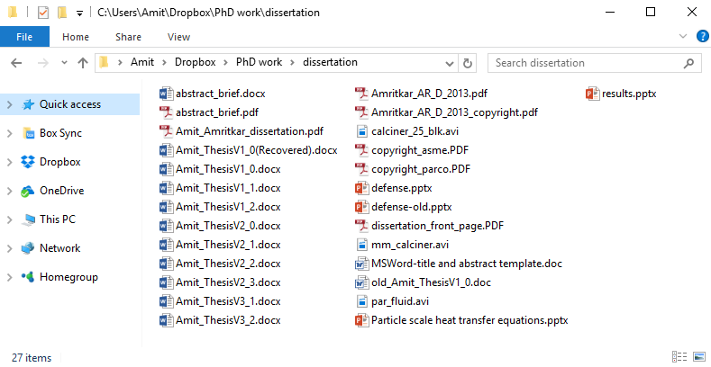
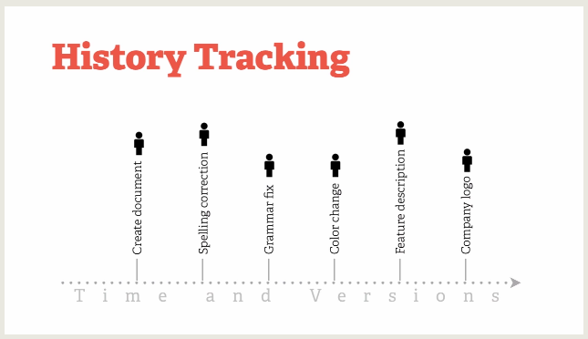
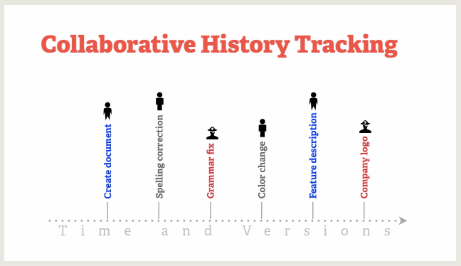
Why use Version control?
Image credit: https://git-scm.com/video/what-is-version-control

Slide 5
Why use Version control?
Reproducibility - know what code was run when
Traceability - know when things were added
Collaboration - allow contributions without risking code breakage
Organization - enforces a method of organization

Slide 6
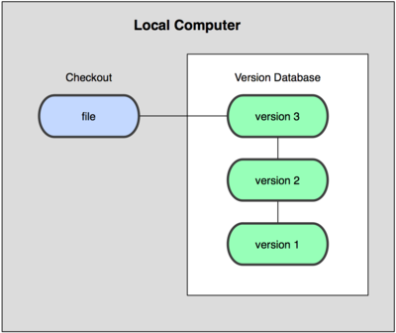
Local Source Control Management
'Database" keeps versions of the file that can be "checked out"
Edit and revise local files
Use smart tools to see differences in the files
[ Image credit: http://git-scm.com ]*
* Creative Commons Attribution 3.0 Unported License
Notes:
*http://git-scm.com/book/en/Getting-Started-About-Version-Control

Slide 7
Local Source Control Management
Examples
SCCS ( 1972)
RCS (1982)
Locking mechanism gives exclusive rights to a user.
[ Image credit: http://git-scm.com ]*
* Creative Commons Attribution 3.0 Unported License
Notes:
*http://git-scm.com/book/en/Getting-Started-About-Version-Control

Slide 8

Centralized Source Control Management
Examples
CVS (1989)
SVN (2000)
ClearCase
Perforce
[ Image credit: http://git-scm.com ]*
* Creative Commons Attribution 3.0 Unported License
Notes:
*http://git-scm.com/book/en/Getting-Started-About-Version-Control

Slide 9
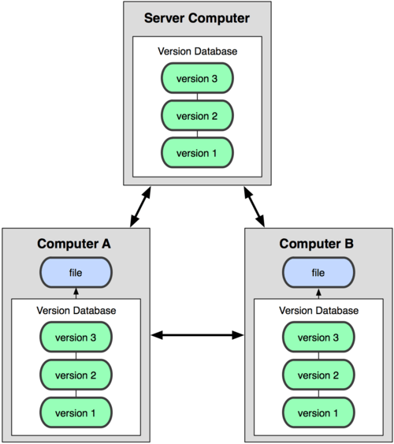
Distributed Source Control Management
Examples
Bitkeeper (2000)
Darcs (2003)
Git (2005)
Bazaar (2005)
Mercurial (2005)
Often called a DVCS: Distributed Version Control System
[ Image credit: http://git-scm.com ]*
* Creative Commons Attribution 3.0 Unported License
Notes:
*http://git-scm.com/book/en/Getting-Started-About-Version-Control

Slide 10
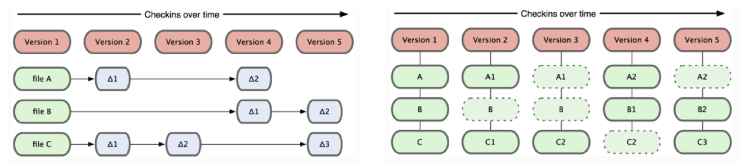
Git is Different
A commit creates a version for your file changes (common to most SCMs)
A commit of your project or file is a snapshot at that moment which has a reference to it. (There is a separate copy, not just a "delta".)
Change(or Delta)-based System
Git, Snapshot-based System
[ Image credit: http://git-scm.com ]*
* Creative Commons Attribution 3.0 Unported License
Notes:
*http://git-scm.com/book/en/Getting-Started-About-Version-Control

Slide 11
Outline
Version Control Management
Basic Git Usage
Checkpointing/restarts

Slide 12
Git
Available on windows, mac and linux
https://git-scm.com/downloads/guis
Command line and GUI interface

Slide 13
Local Commands
git help gives list of commands. You can use man pages, too
git help <command> gives details of a command
$ git help
usage: git ...
$ git help init
GIT-INIT(1) Git Manual
...
Notes:
1st line of text -- lonestar or stampede
Grayed unnecessary text

Slide 14
Local Commands
git init: Create an empty git repository or reinitialize and existing one
$ mkdir git_test
$ cd git_test
$ git init
Initialized empty Git repository in
/home1/01392/amit/git_test/.git/
.git is your local repository.
Notes:
Grayed text

Slide 15
Local Commands
git add: Add file contents to the index (of files) and stages present copy for commitment.
$ echo "Hello Git World" >> README
$ git add README
git_test directory
README
.git
add README
staged
Notes:
Grayed text

Slide 16
Local Commands
git status: Show the working tree status
$ git status
# On branch master
#
# Initial commit
#
# Changes to be committed:
# (use "git rm --cached <file>..." to unstage)
#
# new file: README
1
2
Shows no commitments ( )and a staged file ( ) .
1
2
Notes:
Grayed text

Slide 17
Local Commands
git commit: Record changes to the repository
$ git commit -m "Adding README"
[master (root-commit) 774c810] Adding README
1 file changed, 1 insertion(+)
create mode 100644 README
README
.git
add README
staged
commit
May get message to set your user name and email– so that it knows details of the author.
README
$ git config --global user.name "Your Name"
Notes:
Grayed text

Slide 18
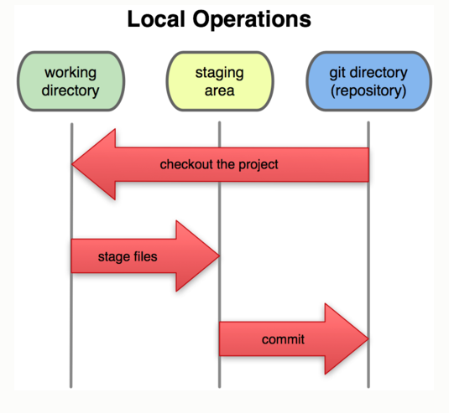
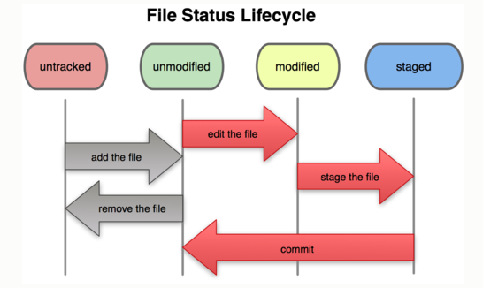
Add and Commit
checkout
←More about this later on.
add
commit
[ Image credit: http://git-scm.com ]*
* Creative Commons Attribution 3.0 Unported License
Notes:
Grayed text

Slide 19
Local Commands
git log: Show the commit logs
$ git log
commit 774c81087d052e43a630db7f676cfd9a6b006772
Author: Amit Amritkar <aramritk@central.uh.edu>
Date: Tue Jul 24 17:53:04 2012 -0500
Adding README
1
Note comment from commit –m option ( Adding README). Make your comments (history) meaningful.
1
Notes:
Grayed text

Slide 20
Local Commands
$ echo "Line 2" >> README
$ git add README
$ git commit -m "Adding Line 2"
$ echo "Line 3" >> README
$ git add README
$ git commit -m "Adding Line 3"
$ echo "Clear file" > README
$ git commit -am "Clear file"
> deletes previous contents of README
add & commit combined, all modified and indexed files
$ git commit –m "Clear file" README #add/commit a file
$ git commit –p –m "Clear file" # query add/commit files
alternate forms
Notes:
Grayed text
Combined last two lines into git commit –am and put note in place.

Slide 21
Local Commands
$ git log commit c0513dbf6b609715f1510c438b9d00f065f7f3f4 Author: Amit Amritkar <aramritk@central.uh.edu> Date: Tue Jul 24 17:58:53 2012 -0500
Clear file
commit 88d4a87be3e7444d06463108e98ca78802f4859e
Author: Amit Amritkar <aramritk@central.uh.edu>
Date: Tue Jul 24 17:58:25 2012 -0500
Adding Line 3
commit 43a446bedd92946d0ccf6fa2218f623284695f8b
Author: Amit Amritkar <aramritk@central.uh.edu>
Date: Tue Jul 24 17:58:01 2012 -0500
Adding Line 2
commit 774c81087d052e43a630db7f676cfd9a6b006772
Author: Amit Amritkar <aramritk@central.uh.edu>
Date: Tue Jul 24 17:53:04 2012 -0500
Adding README
ID
Author
Date
Comments
Note checksum (blobs or
"id") for next slide.
$ git log README #can view log for individual files.

Slide 22
Local Commands
git diff: Show changes between commits, commit and working tree, etc.
$ git diff README #--- staged +++ modified
diff --git a/README b/README
index d5c15a2..fcb6062 100644
--- a/README
+++ b/README
@@ -1,3 +1 @@
-Hello Git World
-Line 2
-Line 3
+Clear file

Slide 23
Local Commands
Types of differences:
Comparison
$ git diff README #staged file with modified README
1
$ git diff 88d4 README #ver 88d4… file with modified README
2
3
$ git diff #staged files with modified files
4
$ git diff 774c #ver 88d4… files with modified files
.git
If there are no staged files,
diff occurs on latest version.
staged
1
committed
3
README
...
C051
88d4
43a4
774c
2
Versions
4

Slide 24
Local Commands
git checkout: Checkout a branch or paths to the working tree
$ git checkout 88d4a87be3e7 Note: checking out ’88d4a87be3e7’.
You are in 'detached HEAD' state. You can look around, make experimental changes and commit them, and you can discard any commits you make in this state without impacting any branches by performing another checkout.
If you want to create a new branch to retain commits you create, you may do so (now or later) by using -b with the checkout command again. Example:
git checkout -b new_branch_name
HEAD is now at 88d4a87... Adding Line 3
$ git checkout master Previous HEAD position was 88d4a87... Adding Line 3
Switched to branch 'master'
Reverts (files) to snapshot 88..
More on branches (-b) http://bit.ly/1YLHDLA.
Revert back to master snapshot (path)
These are the comments!
Notes:
Add red and font increase
Added 3 boxed comments.

Slide 25
Remote Commands
git clone: Clone a repository into a new directory
git pull: Fetch from and merge with another repository or a local branch
git push: Update remote refs along with associated objects

Slide 26
Remote Commands
Bitbucket Repository:
Supports git and other protocols
After creating empty repository:
Import at bitbucket or push files from local system
For convenience name local directory of repository and remote repository the same name
$ #@bitbucket create repository SC
$ mkdir SC; cd SC #create local repo
$ date > README
$ git commit –am "new README"

Slide 27
Push to a Server Repository
$ git remote add origin \ ssh://git@bitbucket.org/amritkar/SC.git
$ git push -u origin –all
$ echo '// No line return' >>p.c
$ git commit -am '2nd commit'
$ git push origin master
<protocol://<site>/<user>/<repo_name>.<repo_type>
First time: push ALL up to site, declare local as upstream
Subsequent pushes: from local master to origin.
Notes:
This replaces a slide with only “git push” and “git pull” examples for remote acces.

Slide 28
Summary of Useful Commands
git status - Show the working tree status
git log - Show commit logs
.gitignore - Include *.o *.a .gitignore (1 line each)
git diff - Shows changes between commits, commit, and working tree, etc.
git remote add <rem_nam> <sit> adds a remote branch

Slide 29
Tips and Tricks
You must add a new file, and then commit it. git commit -a will not work for a new file.
www.gitguys.com/topics

Slide 30
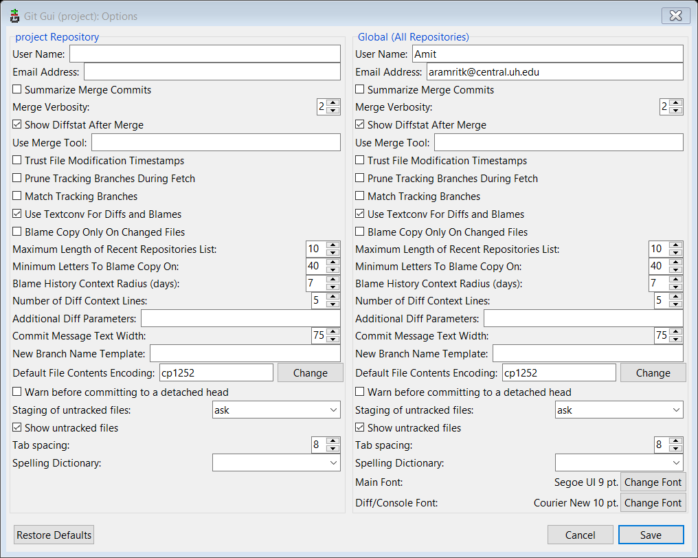
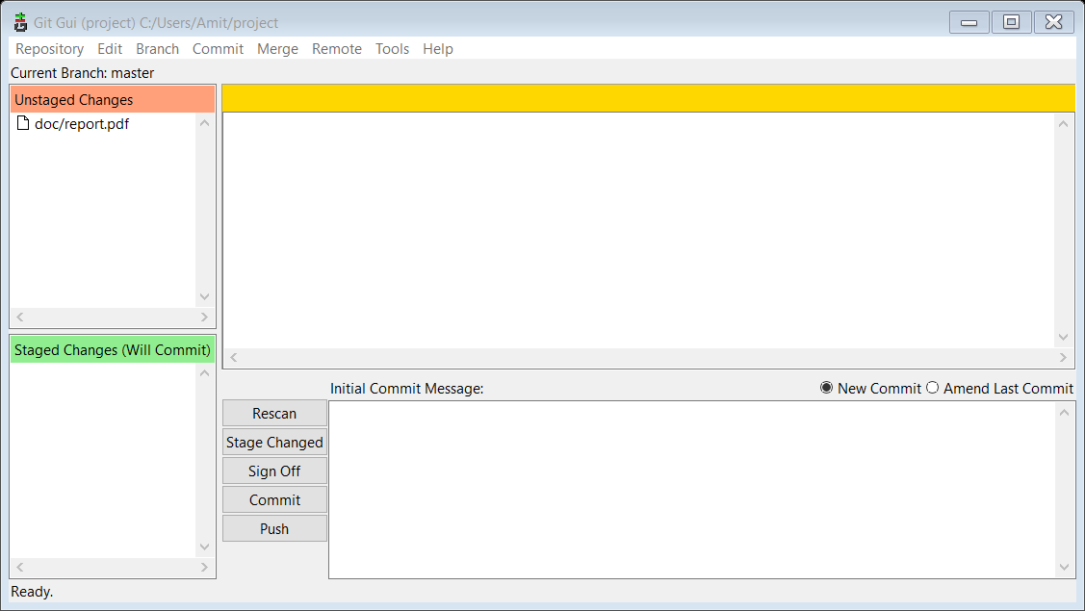
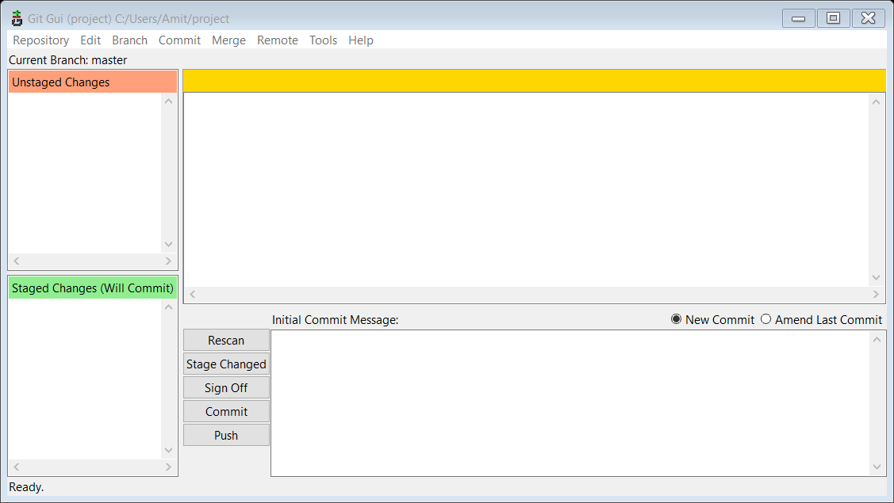

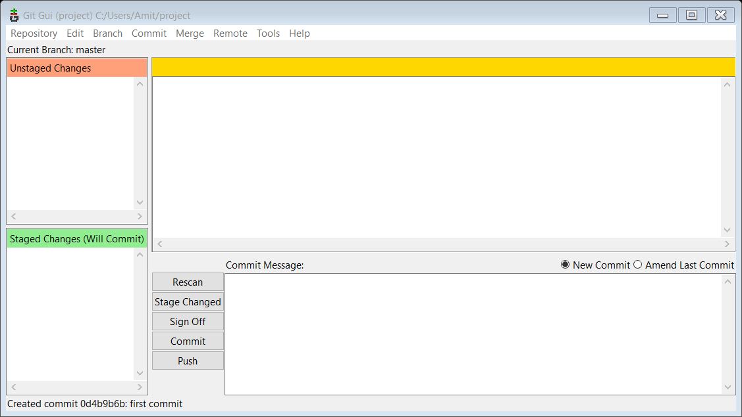
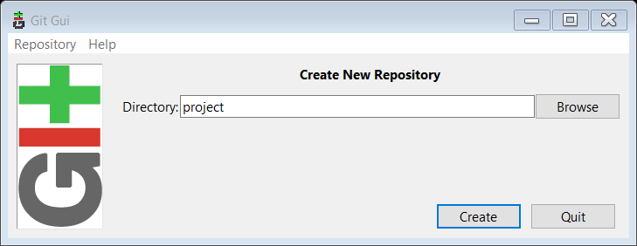
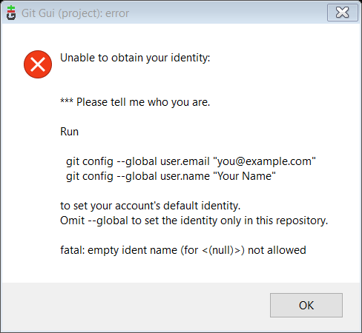
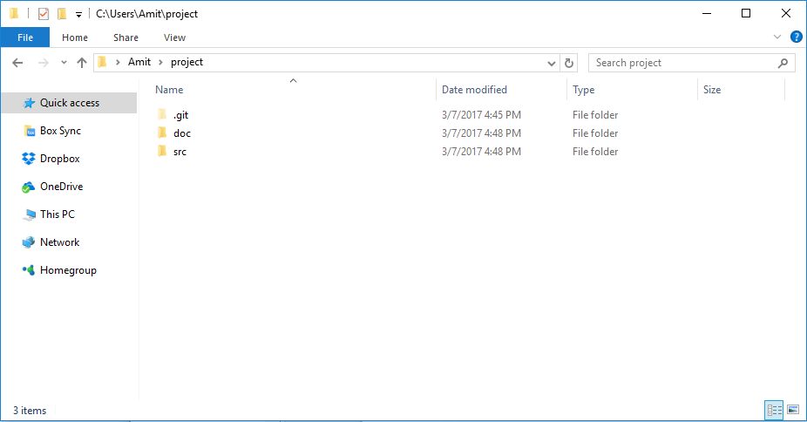
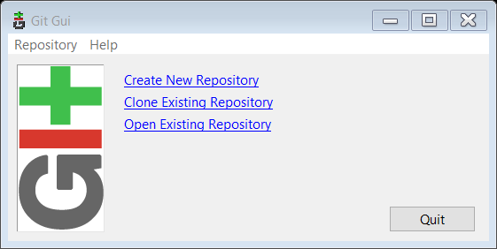
GIT GUI

Slide 31
Outline
Version Control Management
Basic Git Usage
Checkpointing/restarts

Slide 32
Checkpointing/Restarts
A technique to add fault tolerance into computing systems.
Steps to follow,
Periodically save a snapshot of a running application’s state
In case of failure use the last saved snapshot to restart the calculations
Important for long running applications

Slide 33
MATLAB Checkpointing
Data files
save filename var1 var2 …
>> save myfile.mat x y → binary
>> save myfile.dat x y –ascii → ascii
load filename
>> load myfile.mat → binary
>> load myfile.dat –ascii → ascii
if (mod(step,1000)==0)
save restart.mat var1 var2 var3;
end

Slide 34
References
"Science and Technical Computing course materials by The Texas Advanced Computing Center, 2014. Available under a Creative Commons Attribution Non-Commercial 3.0 Unported License"
https://en.wikipedia.org/wiki/Application_checkpointing

Slide 35
Assignment
Convert all your projects/assignment for vistas program to have version control using git and link the repository with bitbucket.org

